Slide 1

Enable Public Cloud Azure App Service
.NET Framework App Migration
- Cloud and DevSecOps Design
AI Cloud and DevSecOps Team

Slide 2




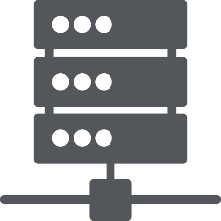
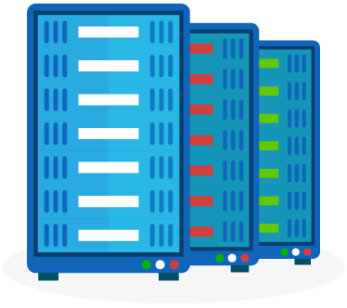



Industry Trend - Applications Are Becoming Digitally Free-Will
Constrained
Boundary-less
Digital Free-will
Use purposeful infrastructure that needs attention and care, constrained by capacity and IT dependency
Build on PaaS, leveraging Infrastructure @ scale through the Azure App Service & be restraint-free.
Exploit, Azure App Service, Edge-computing and infuse cloud nativity making cloud invisible
Application
Abstraction
Low
High
Public Cloud
Public Cloud
Public Cloud
Public Cloud
Infrastructure
Edge
Computing
DC-in-a-Box
Monolithic/nTier IAAS
(Web Based Application)
Hybrid Cloud
(PAAS)
Azure App Service Plan
Purposeful
Scaled
Commoditized

Slide 3
Cloud Migrate Strategy
Rehosting
Lift & Shift
Replatforming
Lift & Shift + Services
Application
Discover/assess/
prioritize
Repurchasing
Replace existing application introducing a standard solution
Refactoring
Refusal of code and development
of a new application
Retire
No Action
Retain
No Action

Slide 4
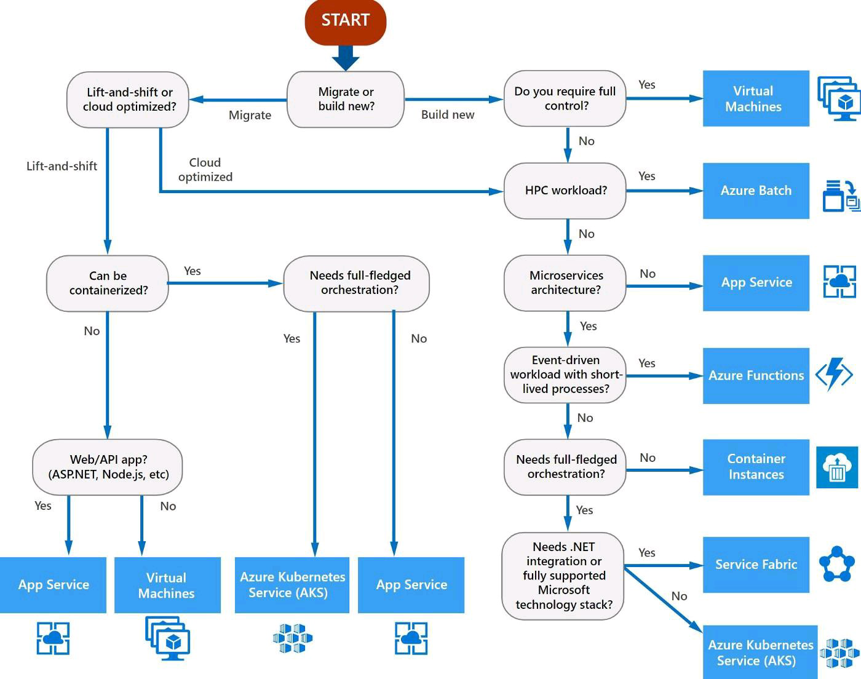
Azure Service Identifications

Slide 5











App Service Business Benefits
Application Centric Operations
ensuring IT agility aligning to Business needs
Business Resiliency
ensuring ‘Always On’ Business Availability
Faster Time To Market
Quicker releases and features to stay ahead of competition
Cost Optimized
Financial Models for greater Predictability
Digital Innovation
driving Digital Enablement & Innovation
Self-Service Models
And Automations
DevSecOps
Scale Up and Down,
Scale Out and In
Auto Scale
Inclusive Security & Compliance
Comprehensive Governance

Slide 6


















Overall Scope
Cloud
Azure Public Cloud
Build Environment
Target Environments
POC,DEV,QA ,UAT,Staging , PROD and DR
Cloud Model
Platform As A Service (PAAS)
Service
Azure App Service
Migration Approach
Migrate the Monolithic .Net Framework Based Application to Containars.
Migrate Application
Tooling/Integration
DevSecOps, CI/CD Tools, GIT, Teamcity, Octopus, Nexus and Azure Load Balancer (ALB)
Monitoring
Splunk, AppDynamics and Azure Monitor
AKS Migration
Provisioning
Azure Automation (CLI/Powershell/ARM Templates), / Azure Portal
Scaling
Scaling Up/Down (Vertical Scaling) and Scaling Out/In (Horizontal Scaling)
Security
and Compliance Governance
Infrastructure Level
Azure Virtual Network, Integrate with Azure AD.
Infra
Azure Service Principles, Azure Active Directory and SSL Certification
Application Level
CheckMark and Sonar.
Identity
Azure Active Directory, IAM, Single Sign On , Domain Services
Self Service
CMDB
ITSM tools – ServiceNow CMDB
Audit
Security Manual Audit, Twistlock and Monitoring logging options ( Cloud Prisma, AppDynamics and Splunk)

Slide 7

App Service Building the Framework Modular approach, meeting the customer in journey
Define strategy
Plan & Design
Ready
Adopt :Migrate
Azure Kubernetees Service
.NET CORE
JAVA BASED APPS
New Microservices with Linux base image
Govern
Manage
App Services
.NET FRAMEWORK
Angular Apps ???

Slide 8




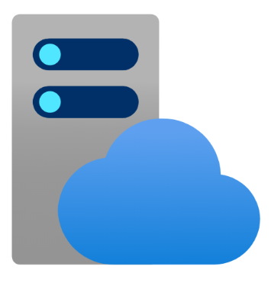








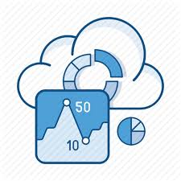




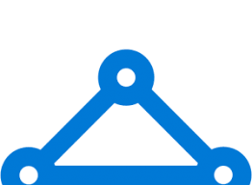

Azure App Service Building Blocks
Provision using SDI (Software Define Infrastructure)
Disaster Recovery/Backup Mode
Security
ARM Templates
Azure App Service Backup
Azure Traffic Manager
Load Balancer
SSL Certificates
Azure App Service Plan
Web App
Web App
Azure App Service Gateway
Azure Active Directory
Networking
Monitoring & Alerting
Equinix Uk South Version
Azure Key Vault
Aetna OnPreim Data Centre
Private Link
App Service
Diagnostics
App Insights
Alert
EventHub
CheckPoint Firewall
Express Route
App Service Regional vNet

Slide 9
App Service Models
SKUs | FREE | FREE | SHARED | BASIC | STANDARD | PREMIUM | ISOLATED
LIMITS
Apps |  | 10 | 100 | Unlimited | Unlimited | Unlimited | Unlimited
Disk space |  | 1 GB | 1 GB | 10 GB | 50 GB | 250 GB
Max Instances |  |  |  | Up to 3 | Up to 10 | Up to 20
SLA |  |  |  | 99.95% | 99.95% | 99.95%
APP DEPLOYMENT
Continuous Deployment |  | Available | Available | Available | Available | Available | Available
Deployment Slots |  |  |  |  | Available | Available | Available
DEPLOYMENT TOOLS
Clone App |  |  |  |  |  | Available | Available
Site Extensions | Available |  | Available | Available | Available | Available | Available
Testing in Production |  |  |  |  | Available | Available | Available

Slide 10
SKUs | FREE | SHARED | BASIC | STANDARD | PREMIUM | ISOLATED
NETWORKING
Hybrid Connections | Available | Available | Available | Available | Available | Available
VNET Integration |  |  |  | Available | Available | Available
Private End Points |  |  |  |  | Available | Available
SCALE
Auto Scale |  |  |  | Available | Available | Available
Integrated Load Balancer |  | Available | Available | Available | Available | Available
Traffic Manager |  |  |  | Available | Available | Available
Backup/Restore |  |  |  | Available | Available | Available
Custom Domains |  | Available | Available | Available | Available | Available
FTP/FTPS | Available | Available | Available | Available | Available | Available
SSL (IP/SNI) |  |  | Available | Available | Available | Available

Slide 11

Azure Service Plan
App Service Plan Represents the collection of physical resources for the App Service.
App Service Plan represents the collection of physical resources for the App Service.
An App Service Plan can have multiple web apps. In other words, we can have multiple web apps in an app service plan.
We can consider an App Service Plan as a single compute resource, i.e., a Virtual Machine. Therefore, for the billing purposes, if we create more than one web apps in a single App Service Plan, we will be charged only once.

Slide 12


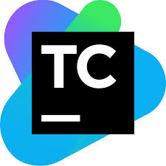




Key Tools Integrated
Azure
Core Features
DevSecOps
Security Tools
Alert and Monitoring
GIT
Azure App service Plan
and web apps
Teamcity
Application Gateway
Octopus Deploy
Azure Virtual Networks

Slide 13





Azure App Service Topology
Management Group
Subscriptions
Resource Group
Virtual Networks
Subnet
Azure App Service Plan & Apps

Slide 14

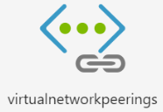

AKS NSG –Production
VN-AI-UKS-PROD-1
VN-AI-UKW-PROD-2
SN-ASPNP-1 /(24)
SN-ASPNP-1 /(24)
NSG Ctrl
NSG Ctrl
App Service Plan
App Service Plan
Web App A
Web App A
Azure LB
Web App N
Web App N
Primary Site (UK South)
Stand By Site (UK West)

Slide 15


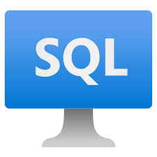
Web App - Private Link
Intranet
App Service Service Regional vNet Integrations
Private Endpoint
App Service Plan
Web App
App Service Subnet
Private Link
DB Subnet
Virtual Network
WEBSITE_VNET_ROUTE_ALL=1
Notes:
Using Azure App Service regional VNet Integration, the web app connects to Azure through an AppSvcSubnet delegated subnet in an Azure Virtual Network.
In this example, the Virtual Network only routes traffic and is otherwise empty, but other subnets and workloads could also run in the Virtual Network.
The App Service and Private Link subnets could be in separate peered Virtual Networks, for example as part of a hub-and-spoke network configuration. For regional VNet Integration, the peered Virtual Networks must be located in the same Azure region.
Azure Private Link sets up a private endpoint for the Azure SQL database in the PrivateLinkSubnet of the Virtual Network.
The web app connects to the SQL Database private endpoint through the PrivateLinkSubnet of the Virtual Network.
The database firewall allows only traffic coming from the PrivateLinkSubnet to connect, making the database inaccessible from the public internet.
https://docs.microsoft.com/en-us/azure/app-service/web-sites-integrate-with-vnet

Slide 16
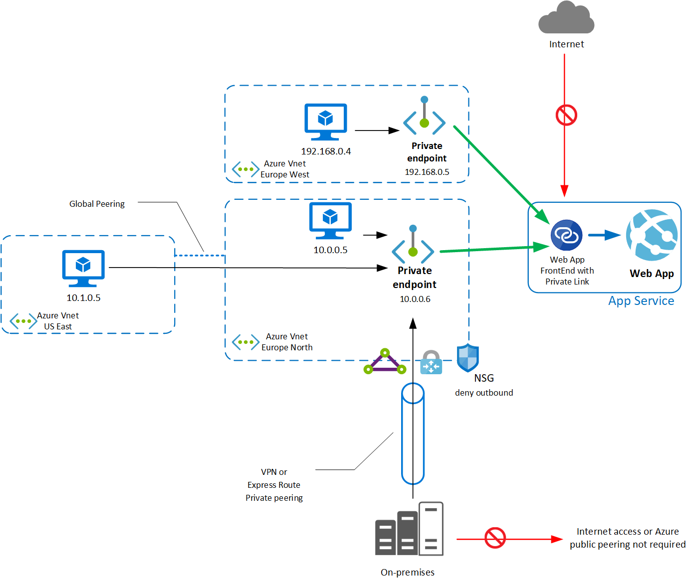

Slide 17

Custom Domain Integration
Internet
App Service vNet Regions Peering
Private Endpoint
Web App
Private Endpoint Subnet
Virtual Network
Custom DNS

Slide 18


Azure DR Structure (Not Implemented)
Azure App Service Plan
Web App 1
Web App 2
Web App 3
Azure App Gateway
Primary Region
User
Azure Traffic Manager
Secondary Region
Azure App Service Plan
Web App 1
Web App 2
Web App 3
Azure App Gateway

Slide 19

App Service Connectivity Splunk Connectivity
Azure App Service Plan
Web App 1
Web App 2
Web App 3
EventHub
hAetna Production Splunk HEC Infrastructure

Slide 20





Monitoring & Alerting
Monitoring
Alerting
Infrastructure Monitoring
Application Monitoring
Omni Bus Event Orchestrator
EventHub

Slide 21












Cloud Native Monitoring & Alerting ( Strategic - Proposed)
Azure Monitor
Insights
Web App
Visualize
Metrics
Analyse
Logs
Respond

Slide 22



DevSecOps Pipeline
Application Developer
GitHub
Teamcity
Continuous Integration (CI)
1
Promotion Approval
POC Stage
POC
3
Dev Stage
Dev
Continuous Deployment
Application Lead
2
QA
Application Lead
QA Stage
Azure
App Service Plan
PROD
QA Lead
PROD Stage
DR

